Slide 1
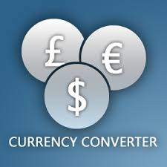
Currency Converter
GUI Application
By-Ravi Gupta
Roll No.-1903480100082

Slide 2
Content
Introduction
Modules Uses
Coding
Working
Advantages
Conclusion
Reference

Slide 3
Introduction
A currency converter is a calculator that converts the value or quantity of one currency into the relative values or quantities of other currencies.
Currency converters aim to maintain real-time information on current market or bank exchange rates, so that the calculated result changes whenever the value of either of the component currencies does.
For example, converting Indian rupee to usd or euro.

Slide 4
Modules Uses
Here we are going to use tkinter, the standard python interface can be used to design and develop this application.
The requests module allows you to send http requests using python.
Json method return json format data into python dictionary data type.

Slide 5
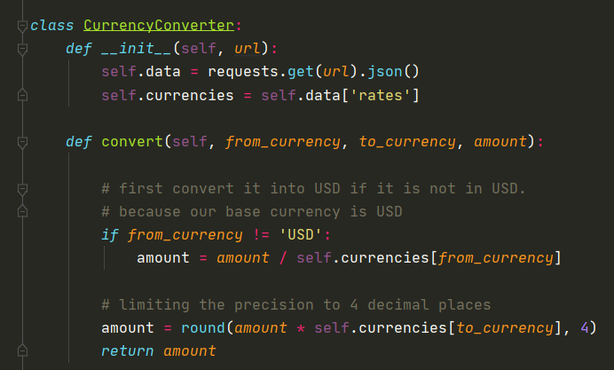
Coding

Slide 6
Working
In order to convert one currency into another, a user enter an amount of money (e.g ‘2000’) and chooses the currency he/she wishes to check the monetary value of (e.g US dollor).
After that , the user selects one, or sometimes several other currencies, he/she would like to see the result.
The application software then calculates and display the corresponding amount of money.

Slide 7
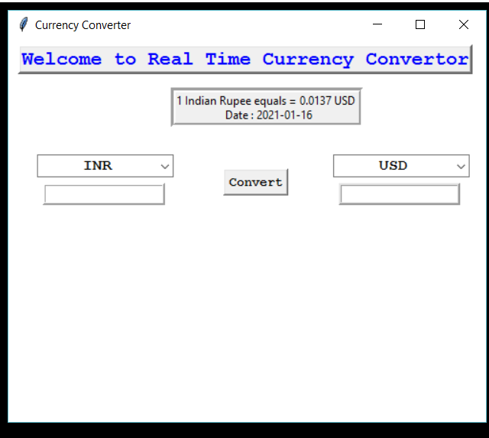
Snap of Application

Slide 8
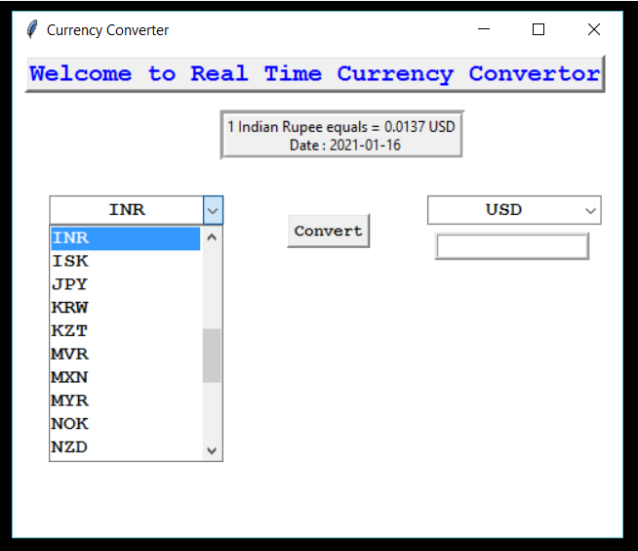

Slide 9
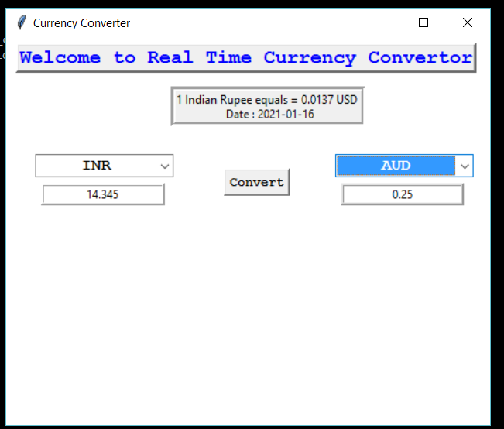

Slide 10
Advantages
An online currency converter is a simple, handy, fast, and accurate tool.
Offers Speedy Operations.
It is Efficient.

Slide 11
Conclusion
Therefore, currency converter is developed and is used for knowing the currency’s value.
It can be further developed by including more currency option, and by shown currency value tables for the user.

Slide 12
Reference
https://www.geeksforgeeks.org/
https://data-flair.training/blogs/currency-converter-python/
Books:
Hand-On Python 3.x GUI Programming.
Advanced Python Programming.

Slide 13


Slide 14
Any Question ?

